Slide 1
Netflix STOCK Profile FOR 2017 FISCAL YEAR
By riliwan lawal
june 27,2020

Slide 2
Table of contents
Introduction
Abstract
Objectives
Findings
Distribution of Stock Prices
Actual vs Estimated Earnings per Share
Earnings and Revenues per Quarter
Comparison of Netflix and Dow Jones Average prices
conclusion

Slide 3
1. introduction

Slide 4
Abstract
In this project, I acted as a data analyst at Yahoo Finance and I will be helping the "Netflix Stock Profile" team TO visualize the Netflix stock data.
In finance, a stock profile is a series of studies, visualizations, and analyses that dive into different aspects OF a publicly traded company's data.
We only considered the 2017 fiscal year data and analyse Netflix stock against dow jones stock
objectives
For the purpose of this project, we will only visualize data for the year 2017 , Specifically I WILL BE overseeing the creation Of the following visualization
the distribution of the stock prices for Netflix in 2017
a summary of Netflix stock and revenue for the past four quarters
summary of their earned versus actual earnings per share
Netflix stock against the Dow Jones stock (to get a sense of the market) in 2017

Slide 5
2. findings

Slide 6
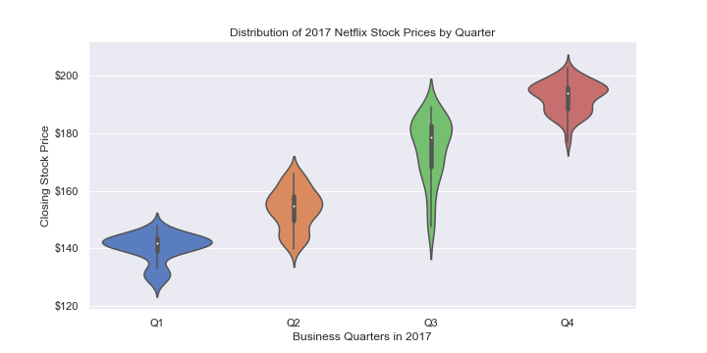
Distribution of stock prices
The stock price generally increased every quarter.
Prices fell most in the first quarter
The lowest closing price stock is $127.49
The highest closing price stock is $202.68

Slide 7
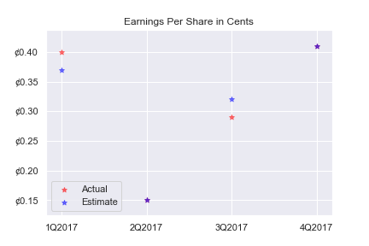
actual vs estimated Earnings Per Share
The Range of earning per share was between 0.10 and o.45 cents.
In the second and fourth quarter the prediction was totally accurate
Netflix shares traded better in the first quarter than the third quarter

Slide 8
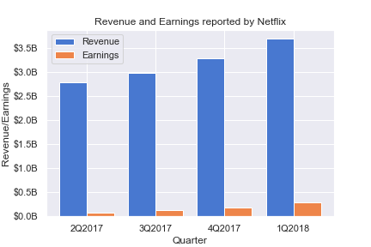
Earnings AND REVENUE PER QUARTER
BOTH REVENUES AND EARNINGS ARE GROWING WITH AN UPWARD TREND
ABOUT 6-7% OF REVENUE CONSTITUTES EARNINGS

Slide 9
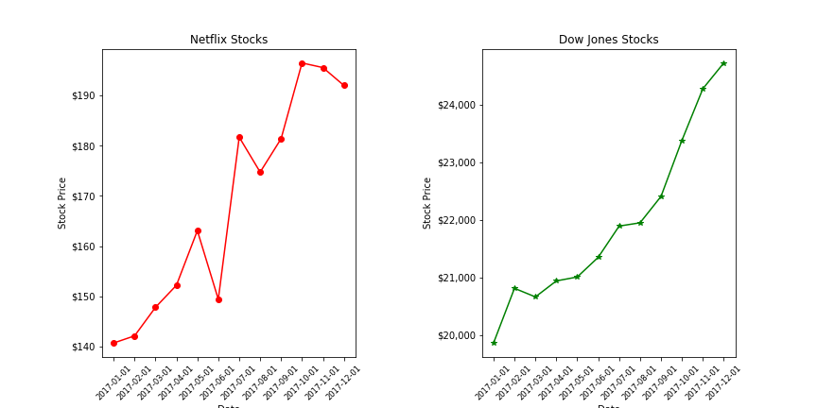
Netflix stocks vs dow jones stocks
Netflix performed relative low compared to Dow Jones, because its stocks had about 4 down times within the year compared to Dow Jones who only had just one down time.
The ascent trend was similar. But Netflix stock was more irregular
Netflix was more volatile AND IT HAD BIGGER FLUCTUATIONS

Slide 10
3. CONCLUSION

Slide 11
CONCULSION AND RECOMMENDATION
In 2017 Netflix stock experienced a constant growth with some volatility along the way.
THE STOCK PRICE PERFORMED VERY WELL AT THE LAST QUARTER
I RECOMMEND THAT NETFLIX INVESTIGATE HOW TO REDUCE THW OPERATING COST SO AS TO INCREASE EARNING AND ALSO INCREASE ITS STOCK PRICE.

